Slide 1


Artificial Intelligence and Machine Learning at UC Santa Cruz

Slide 2
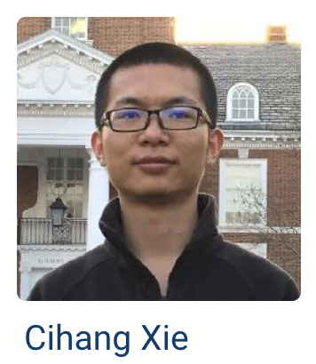
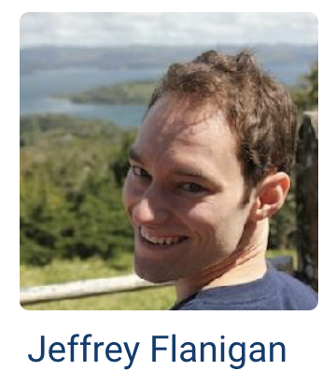
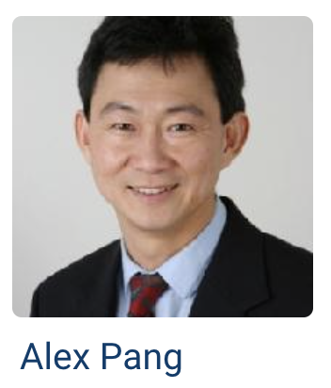
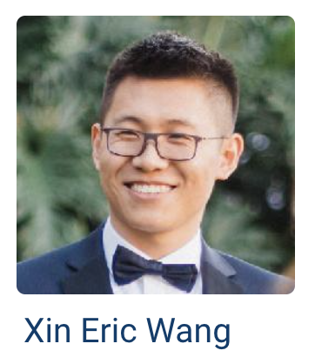
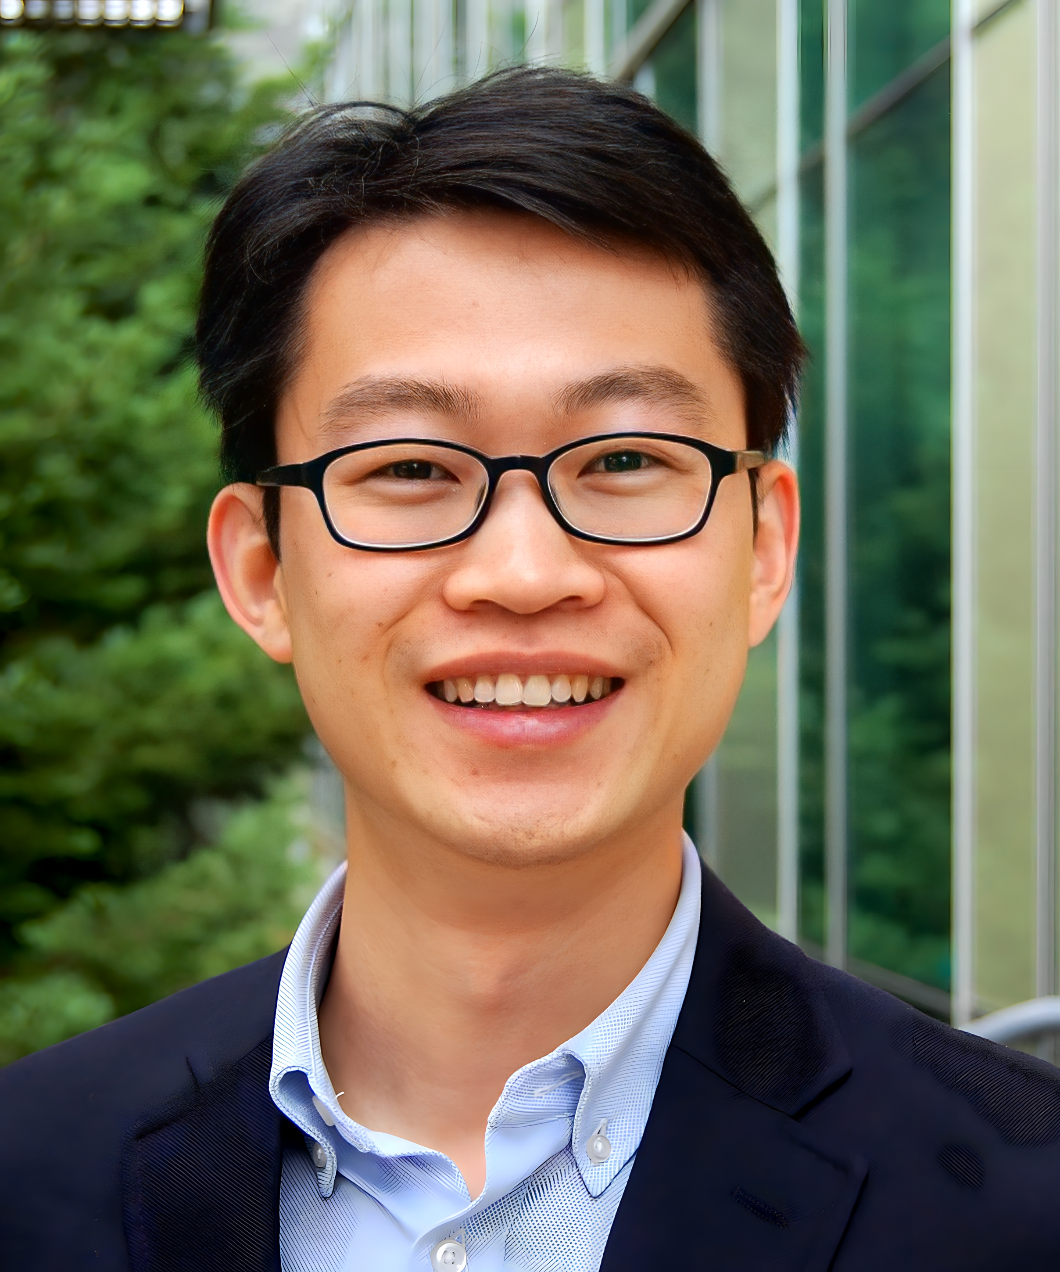

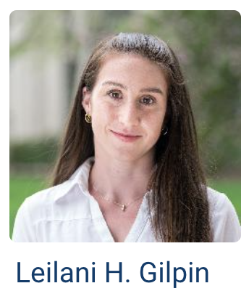
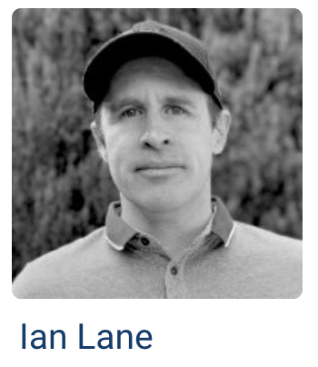
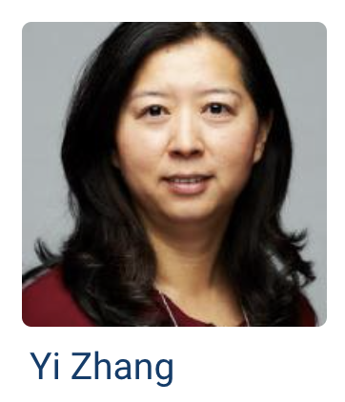
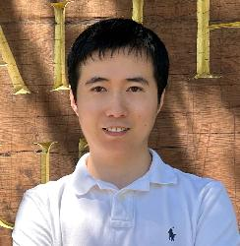

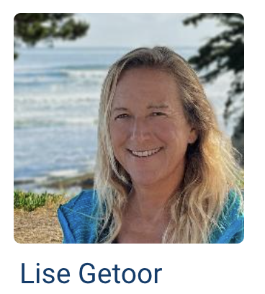
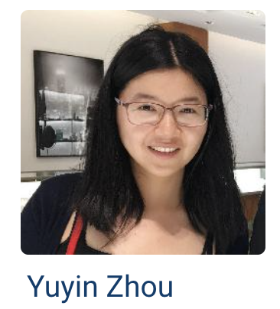
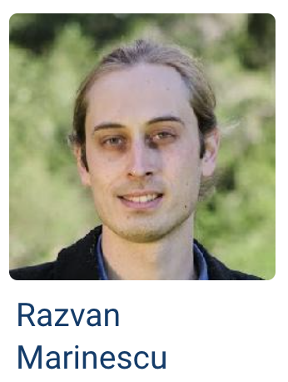
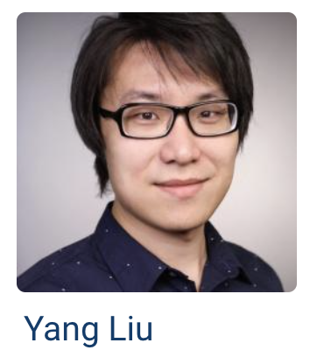

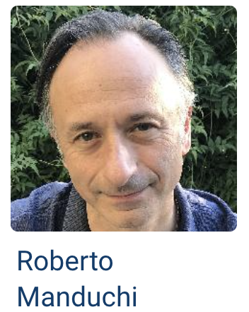
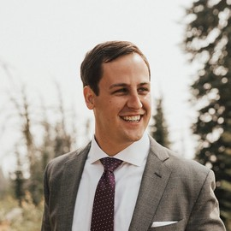
AI faculty
Computer Vision and Graphics
Natural Language processing
Cyber-physical systems & wireless communication
Yu Zhang
Hao Ye
ML in Healthcare
Theoretical ML
Vaggos Chatziafratis
Ashesh Chattopadhyay
Paul A. Parker

Slide 3
Research areas
Computer Vision
Natural Language Processing
Medical Image Analysis
Multimodal Modelling (Vision + Text, Imaging + Cognitive Tests)
AI for people with disabilities

Slide 4
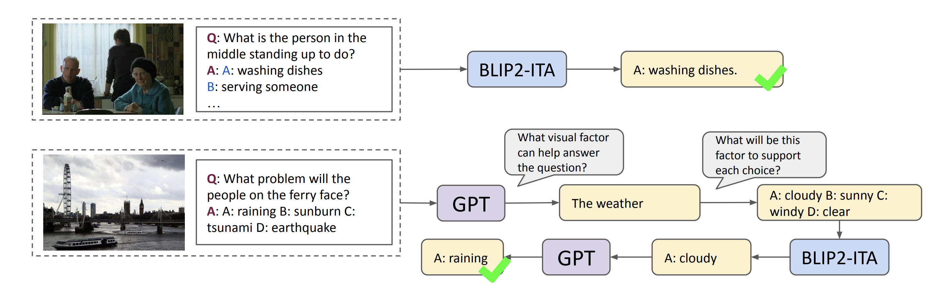
Multimodal Computer Vision + NLP
Visual question answering through LLMs
Aim: Perform visual reasoning

Slide 5
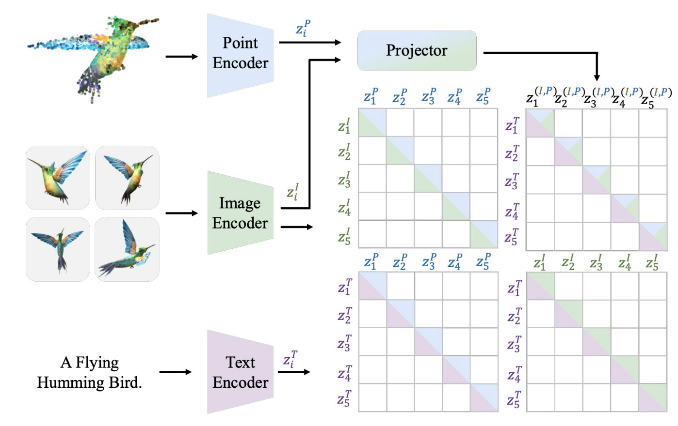
Learning efficient multimodal representations
Embedding combines points clouds, images and text
Gao, 2024, CVPR

Slide 6
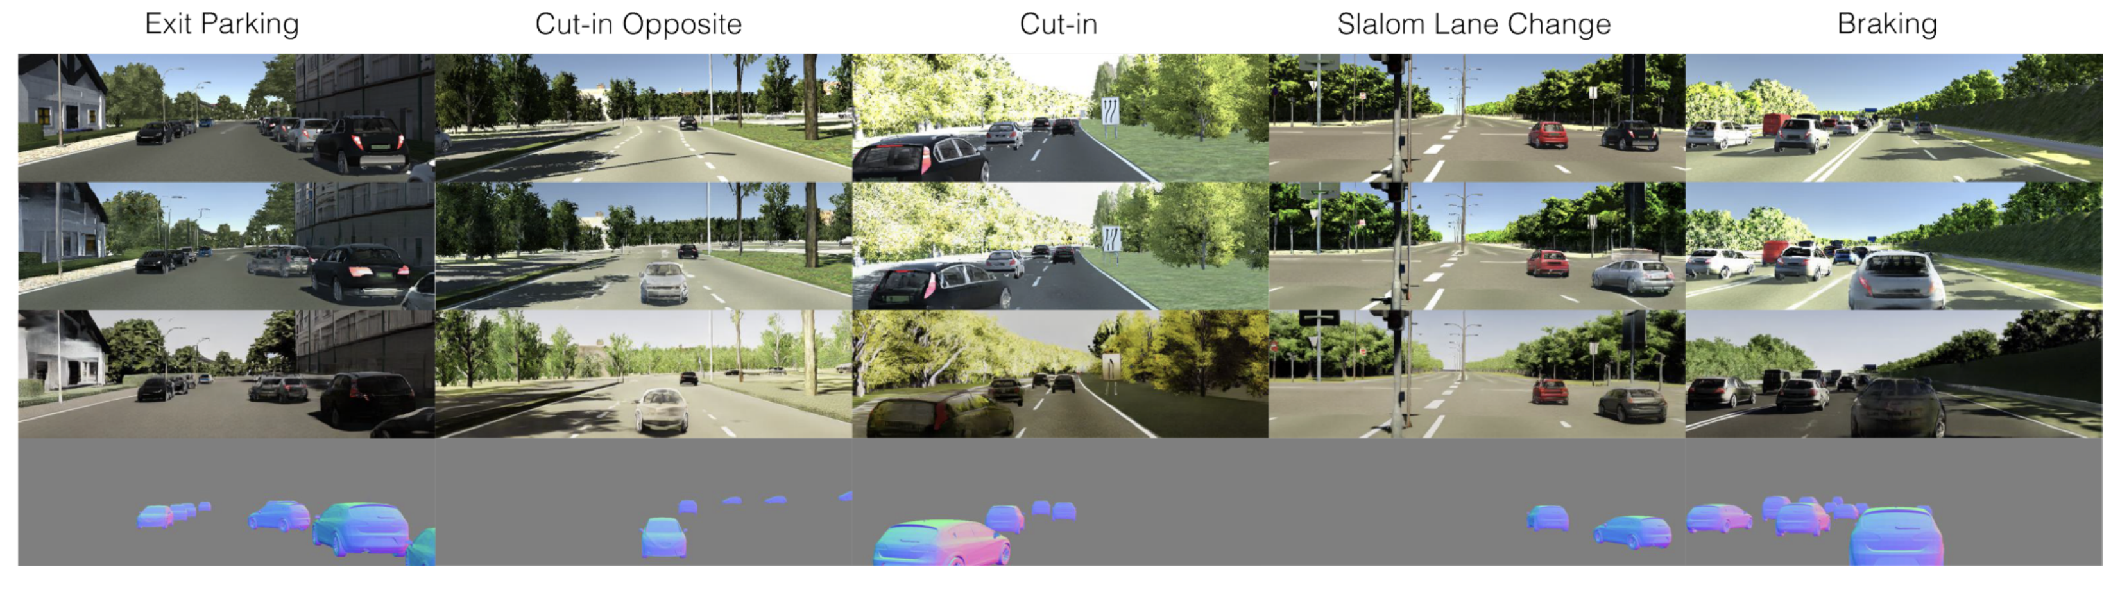
Reliable and trustworthy AI
ML fairness
Explainable models by design
ML robustness to corner cases, rare events, …

Slide 7
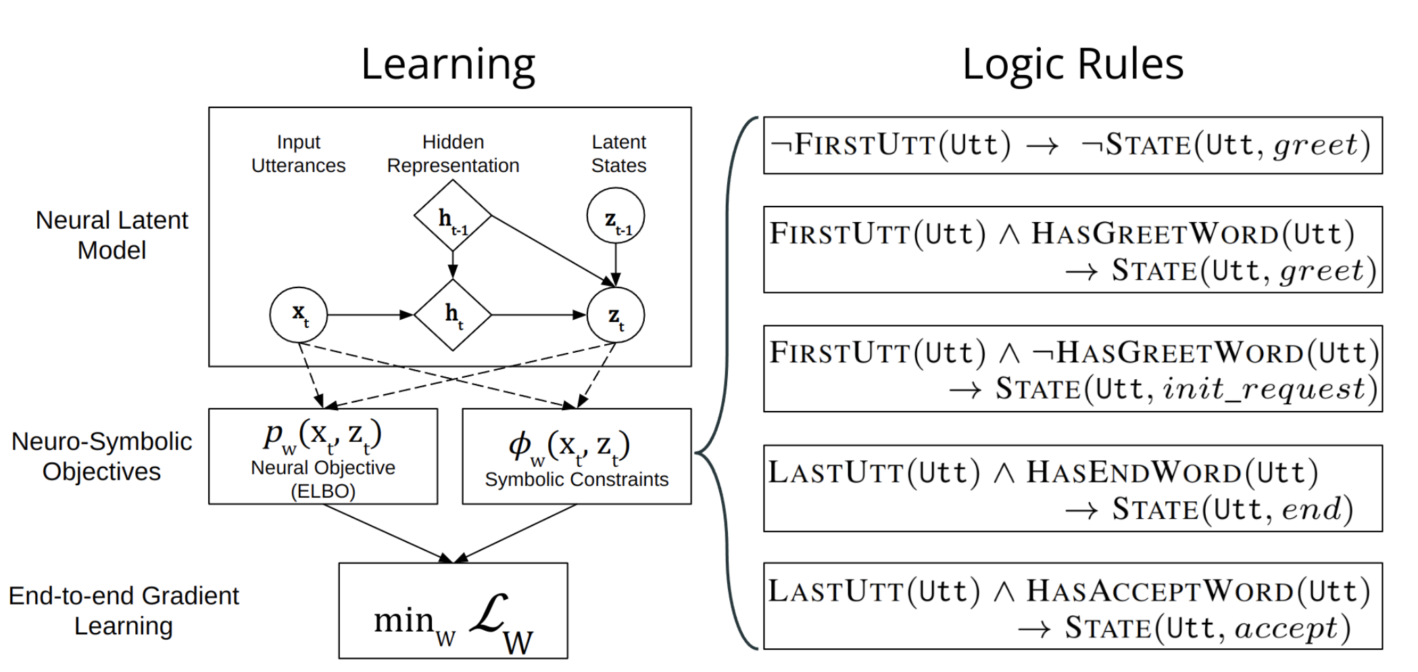
Probabilistic soft logic and neurosymbolic learning
PSL incorporates probabilities and uncertainty in logical reasoning rules
Recent work has combined PSL with neural nets to learn rules using gradient-based learning

Slide 8
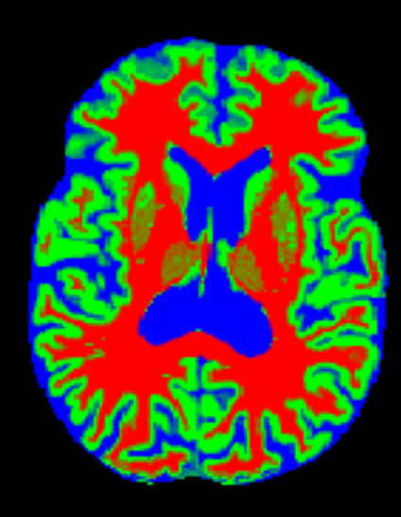
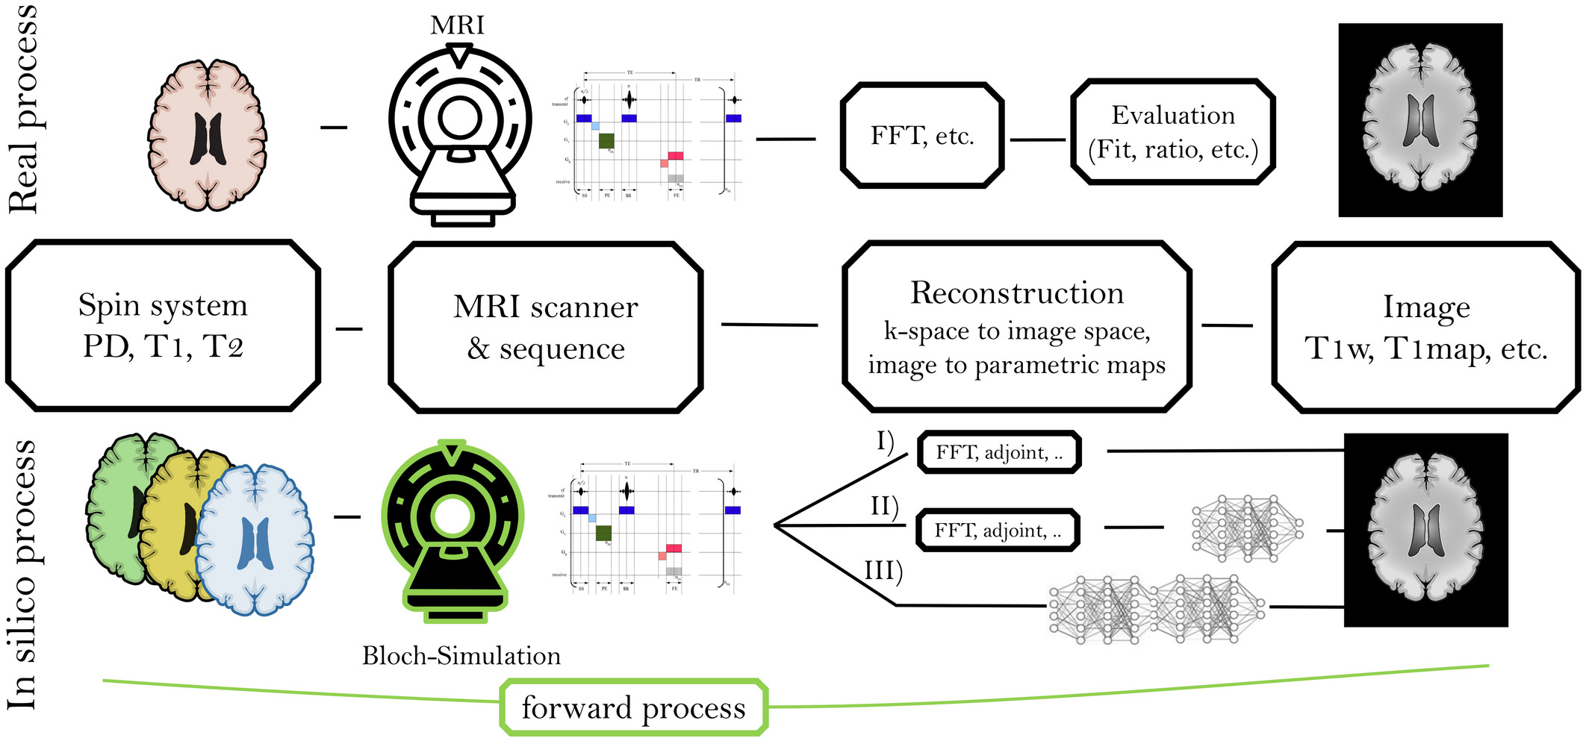
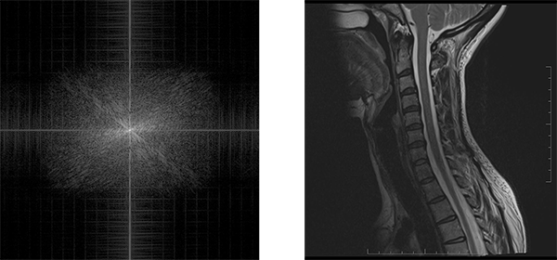
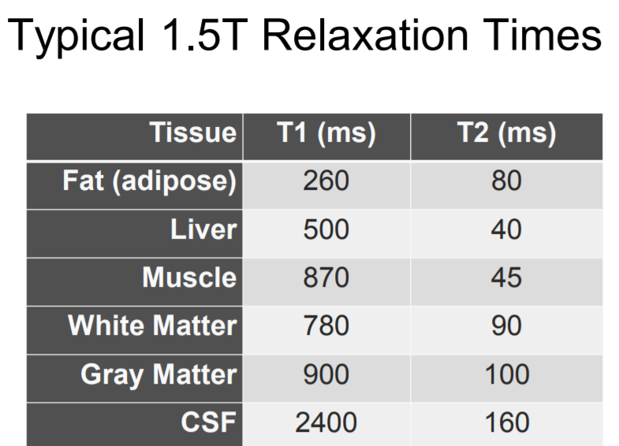
Differentiable physics-based simulators
Back-propagate the loss to the digital phantom
Inverse problem + ill-posed
Digital phantom
K-space
simulated T1-weighted
T1/T2/PD
% GM
% WM
% CSF
MRI simulator
loss
Sequence params: TE, TR, flip angle, …
real T1-weighted

Slide 9
Short research description from Ian Lane and Roberto Manduchi

Slide 10



AI start-ups at UC Santa Cruz
Leveraging our position in Silicon Valley
First speech translation for iPhone
Conversational AI assistant
Virus simulations

Slide 11


Student initiatives in AI @ UC Santa Cruz

